Slide 1
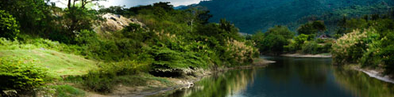

Improving Philippine Water Governance
26 February 2020

Slide 2
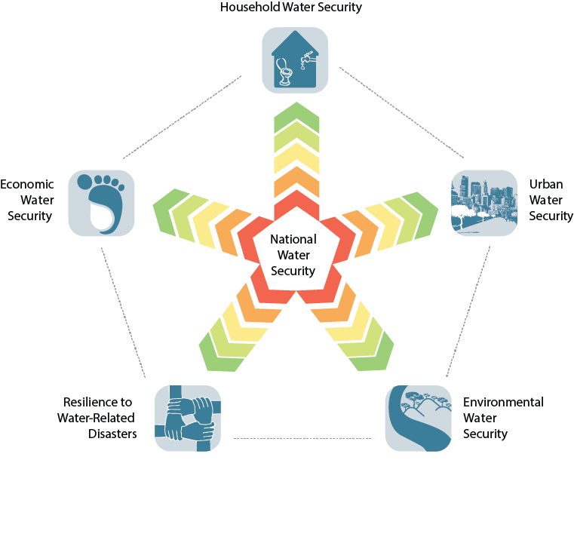
Household water security is an essential foundation for efforts to eradicate poverty and support economic development
ADB Water Security Framework of
Five Interdependent Key Dimensions
Economic water security measures the productive use of water to sustain economic growth in the food production, industry, and energy sectors of the economy
Urban water security indicators measure the creation off better water management and services to support vibrant and livable water-sensitive cities
Environmental water security assesses the health of rivers and measures progress on restoring rivers and ecosystems to health on national and regional scale
The building of resilient communities that can adapt to change and are able to reduce risk from natural disasters related to water must be accelerated to minimize the impact of future disasters.

Slide 3
Baguio
Bulacan
Laguna
Tacloban
Iloilo
Cebu
Bohol
Cagayan de Oro
Zamboanga

Slide 4
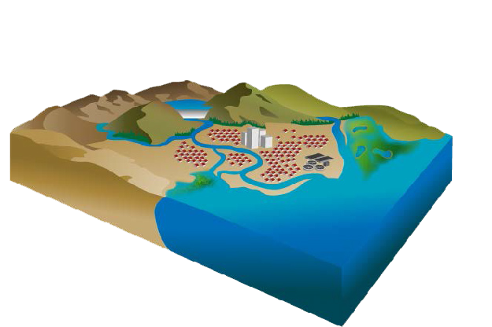
Impact of Climate Change on Water Resources
Degraded water quality and treatment challenges
Lower reservoir levels & water shortages
Stormwater mgmt. challenges
Central flooding from storm surges
Reduced groundwater recharge
Saltwater intrusion into aquifers
Loss of wetlands and ecosystems
Increased frequency & extent of floods
Increased residential demand

Slide 5
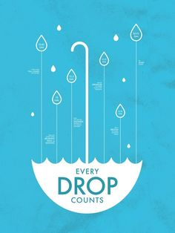
“The main problem is not the physical scarcity of water, but its continued mismanagement”
-Asit Biswas
Stockholm Water Prize Winner

Slide 6
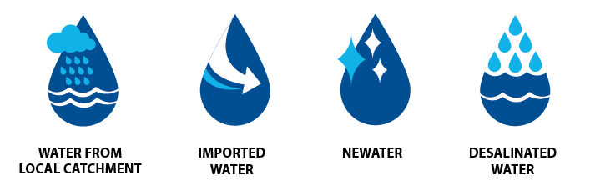
Singapore 4 Tap System

Slide 7







There are more than 30 government agencies involved in the Philippine Water Sector
NEDA NWRB
DPWH DENR
Policy Making
& Coordination
NWRB DOE
PSALM DENR
PEMC
NWRB MGB
DPWH-BOD NEDA
PAGASA DOST
Hydropower
Data Collection
& Research
NWRB DA
NIA BSWM
BFAR
DPWH MMDA
PAGASA LGUs
Agriculture
Flood
Management
NWRB DPWH EMB
MWSS CDA DILG
NAPC HLURB DOH
PEZA/TIEZA LGUs
Water Districts LWUA
NWRB DENR
RBCO LLDA
NCIP LGUs
River Basin &
Watershed Mgmt
Water &
Sanitation

Slide 8
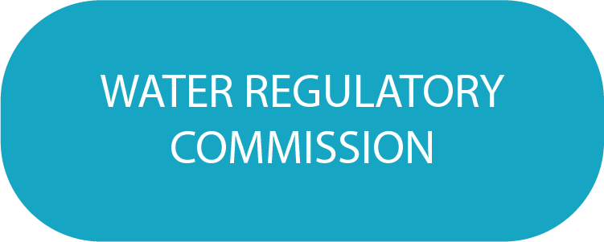


Slide 9
Functions of the Department
Policy Making and Planning
Resource Regulation
Institutional Arrangements with Public Water Organizations
Coordination

Slide 10
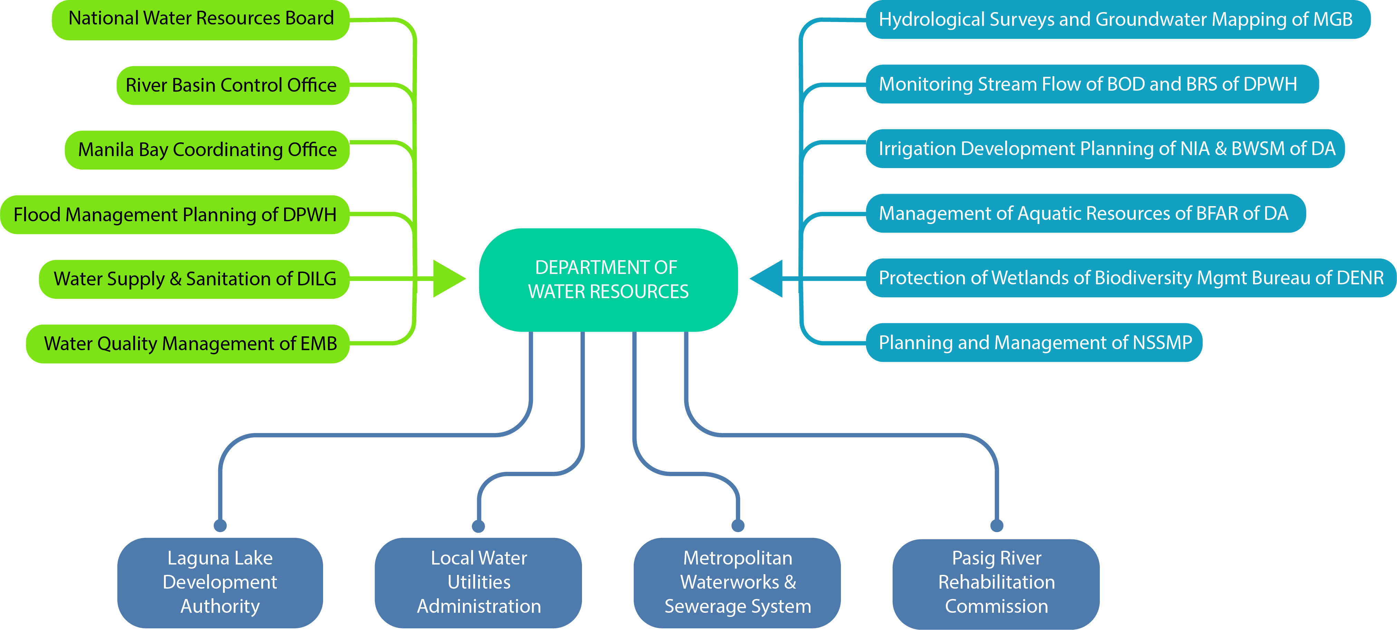

Slide 11
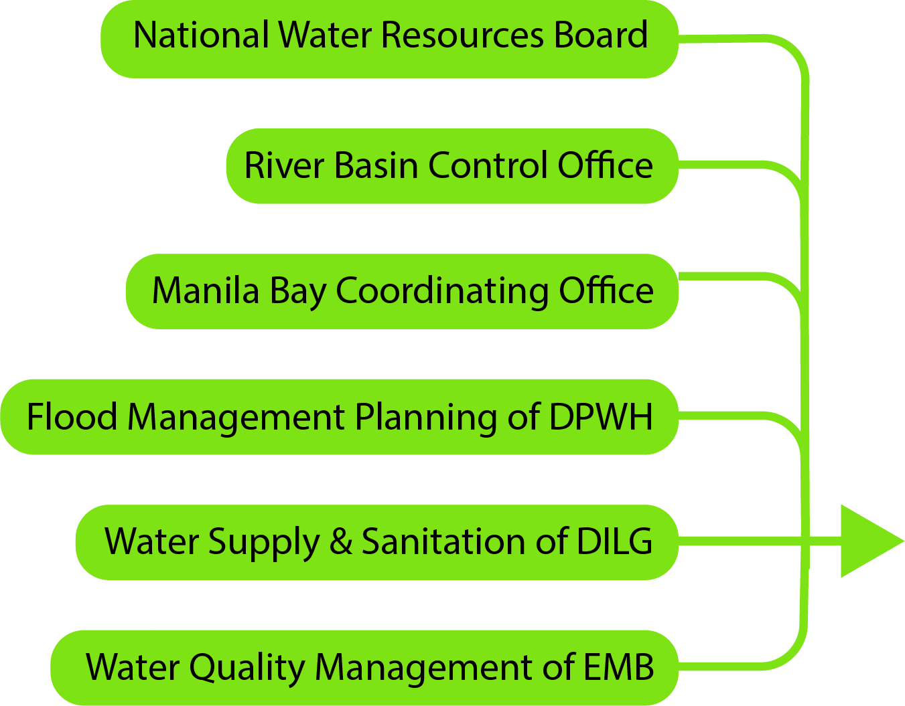
Offices Absorbed by DOWR

Slide 12
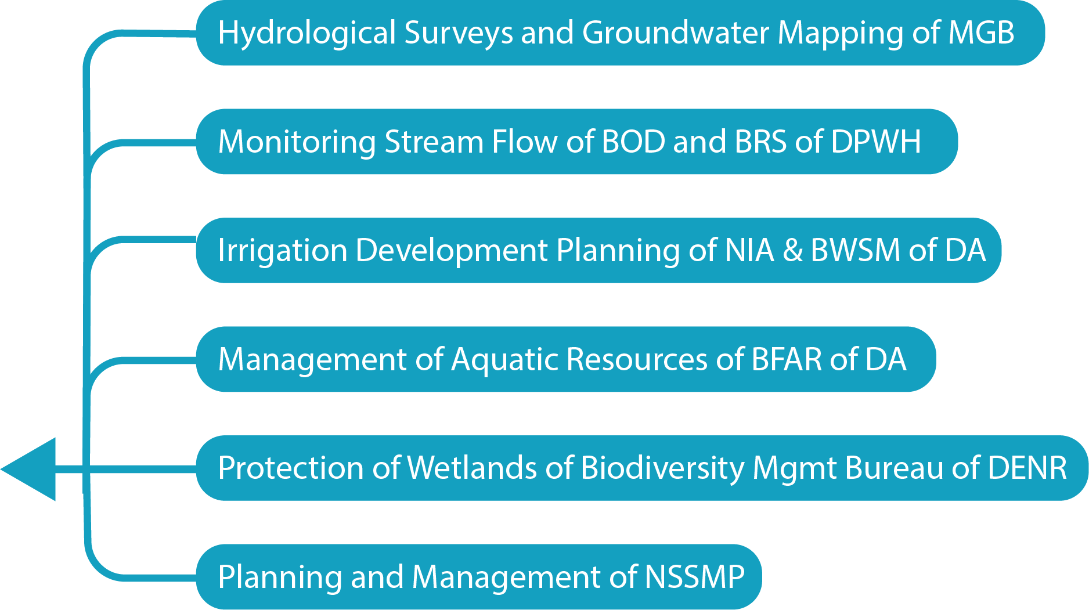
Functions Transferred by the DOWR

Slide 13
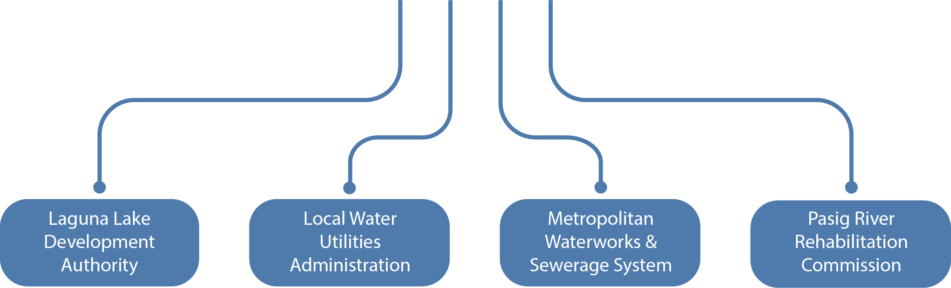
Attached Agencies to the DOWR

Slide 14
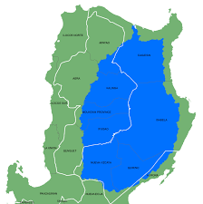
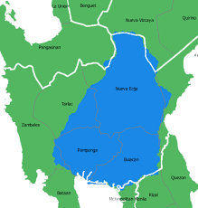
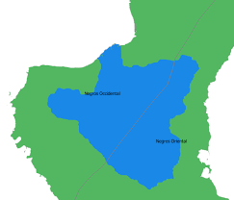
River Basins allow those who live off the resource to manage their own resource

Slide 15
Department of Water Resources
River Basin Organization
River Basin Organization
Water Regulatory Commission
Water Utility
Water Utility

